Slide 1

Unit-2 IoT Physical Devices and Endpoints
Internet of Things (IoT)
DU 2101CS631
DU 2301OE003
Prof. Bhushan D. Joshi
Computer Engineering Department
bhushan.joshi@darshan.ac.in
+91 8485979997

Slide 2
Unit 2-A: IoT Physical Devices and Endpoints
IoT and M2M
Machine to Machine Communication
Software Define Network
IoT Data Acquisition

Slide 3
IoT : Internet of Things
Internet of Things : IoT is known as the Internet of Things, where things are said to be the communicating devices that can interact with each other using a communication media.
Usually every day some new devices are being integrated which uses IoT devices for its function.
These devices use various sensors and actuators for sending and receiving data over the internet.
It is an ecosystem where the devices share data through a communication media known as the internet.
IoT is an ecosystem of connected physical object that are accessible through internet.
IoT means anything which can be connected to internet and can be controlled or monitored using internet from smart devices or PC.

Slide 4

M2M : Machine To Machine
Machine-to-Machine, describes a communication method in which two or more machines interact via wireless or wired connections without human intervention. It refers to the direct communication between devices.
M2M is another mode of creating connection between machines to transfer information and data from one machine to another machine.
M2M uses Point-to-Point connection method. It has varied use nowadays.
M2M is an technology that helps the devices to connect between devices without using internet.
M2M is only subset of IoT .

Slide 5
IoT vs M2M
 | IoT | M2M
Abbreviation | Internet of Things | Machine to Machine
Intelligence | Devices have objects that are responsible for decision making | Some degree of intelligence is observed in this.
Connection type used | The connection is via Network and using various communication types. | The connection is a point to point
Communication protocol used | Internet protocols are used such as HTTP, FTP, and Telnet. | Traditional protocols and communication technology techniques are used
Data Sharing | Data is shared between other applications that are used to improve the end-user experience. | Data is shared with only the communicating parties.

Slide 6
IoT vs M2M
 | IoT | M2M
Internet | Internet connection is required for communication | Devices are not dependent on the Internet.
Type of Communication | It supports cloud communication | It supports point-to-point communication.
Computer System | Involves the usage of both Hardware and Software. | Mostly hardware-based technology
Scope | A large number of devices yet scope is large. | Limited Scope for devices.
Business Type used | Business 2 Business(B2B) and Business 2 Consumer(B2C) | Business 2 Business (B2B)
Open API support | Supports Open API integrations. | There is no support for Open APIs

Slide 7
Software defined Network(SDN)
SDN stands for Software Defined Network , which is a networking architecture approach.
SDN enables the control and management of the network using software applications.
Through Software Defined Network (SDN) networking behavior of the entire network and its devices are programmed in a centrally controlled manner through software applications using open APIs.
To understand software-defined networks, we need to understand the various planes involved in networking.
Data Plane
Control Plane
Data plane: All the activities involving as well as resulting from data packets sent by the end-user belong to this plane. This includes:
Forwarding of packets.
Segmentation and reassembly of data.
Replication of packets for multicasting.

Slide 8
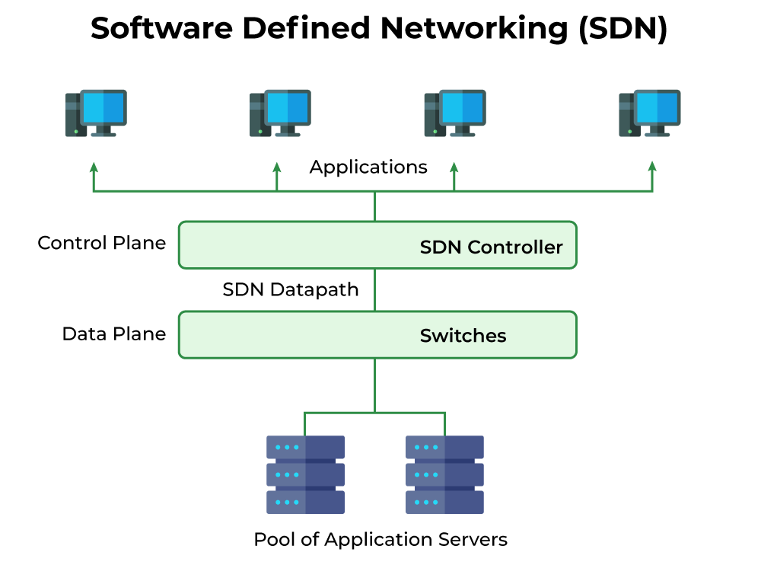
SDN
Control plane: All activities necessary to perform data plane activities but do not involve end-user data packets belong to this plane.
This is the brain of the network.
The activities of the control plane include:
Making routing tables.
Setting packet handling policies.

Slide 9
IoT Data Acquisition System
Data acquisition (DAQ) and protocols are pivotal building blocks of IoT technology.
A data acquisition device helps users to make machines smarter by gathering and analyzing real-time data.
After the acquisition of Data, Data should be converted in proper Protocol format.
IoT protocols enable to exchange data in an organized and significant manner.
Data Acquisition played two critical roles:
1. Identity : Identify the data (Sensor and Data Type)
2. Authentication : (Authenticity of Data)

Slide 10
Unit 2-B: Arduino
Microcontroller's Architecture
Introduction to Arduino
Arduino Species
Arduino Uno Architecture
Arduino Uno Specifications
Arduino IDE
Arduino Programming

Slide 11

Examples of 8-bit µC
Motorola’s 6811
Intel’s 8051
Zilog’s Z8
Microchip’s PIC
The 8051 family has the largest number of diversified (multiple source) suppliers:
Intel (original)
ATMEL
Philips/Signetics
AMD
Infineon (formerly Siemens)
Dallas Semiconductor/Maxim

Slide 12
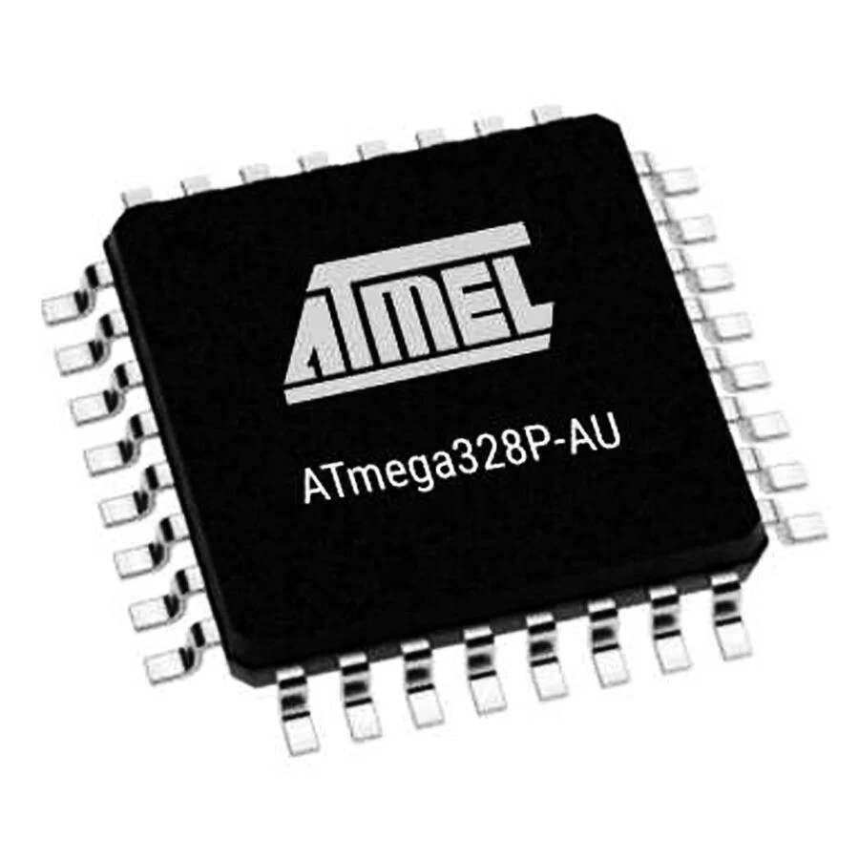
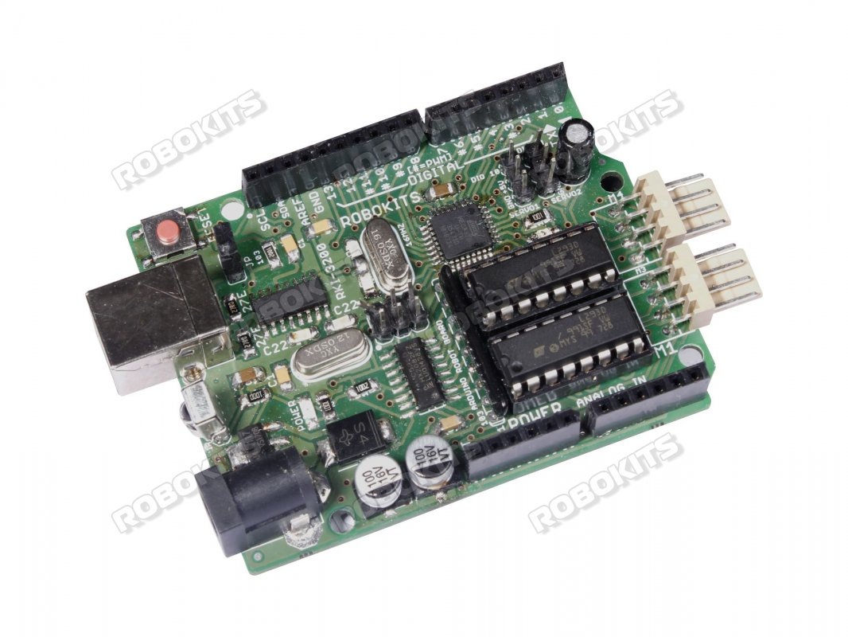
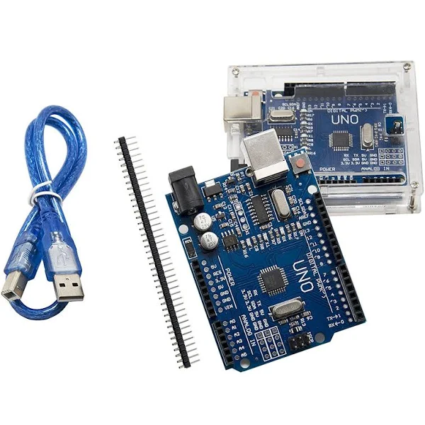
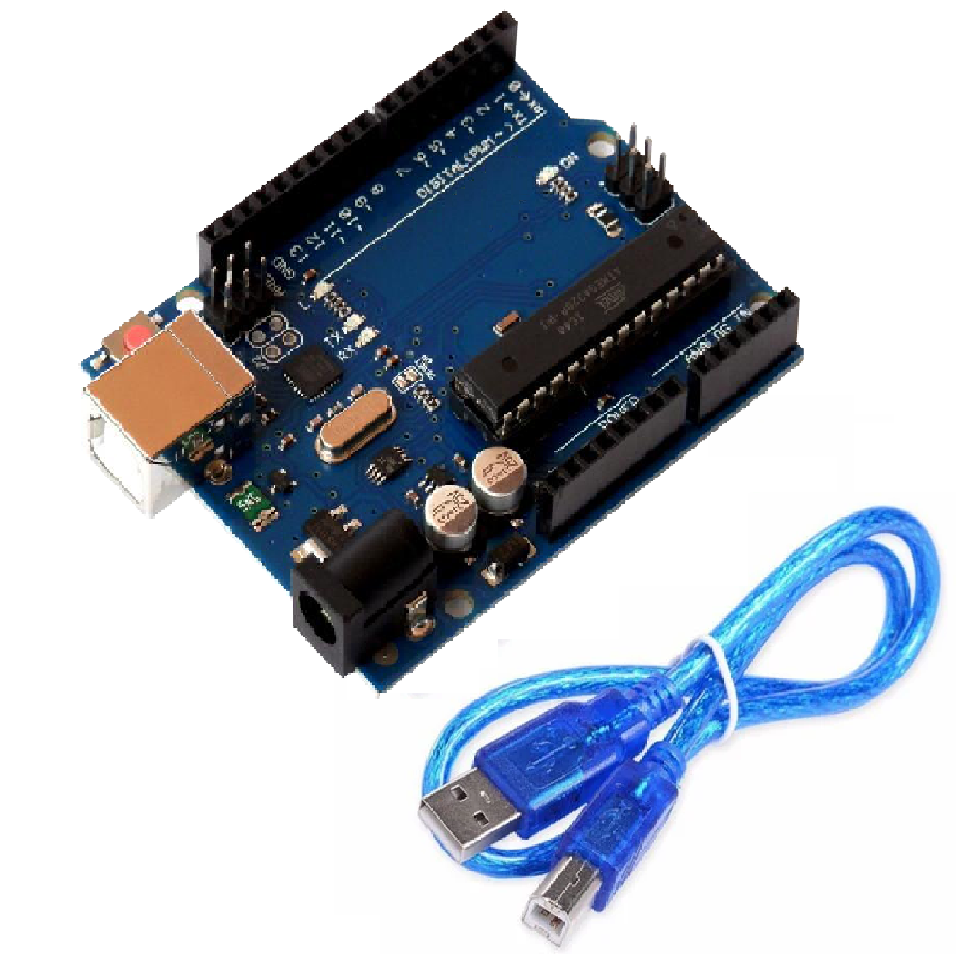
The Microcontroller inside Arduino UNO : Atmel ARV ATmega328
The Arduino Uno is an open-source microcontroller board.
This board is based on the Microchip ATmega328P microcontroller.
The Board is developed by Arduino.cc.
The Microcontroller inside the board is manufactured by Atmel.
Robu.in : ₹ 600.96
Robokits.co.in : ₹ 797
Amazon.in : ₹ 499
UNO R3 + MOTOR SHIELD

Slide 13
ATmega328P : Architecture
 | On-chip Memory
 | 3 Separate
 | SRAM: 2 KiB 8 bits - store data Flash (ROM) :32KiB 16 bits - program code EEPROM : 1KiB 16 bits - small data
 | Memory And Instructions
 | RISC 8 bit Harvard
 | Native data size 8 bits (1 byte) 16-bit data addressing
 | Communication Port
 | Port
 | Digital input/output Analog input Serial/Parallel Pulse accumulator
Instruction
On-Chip Memories
Input- Output Port

Slide 14
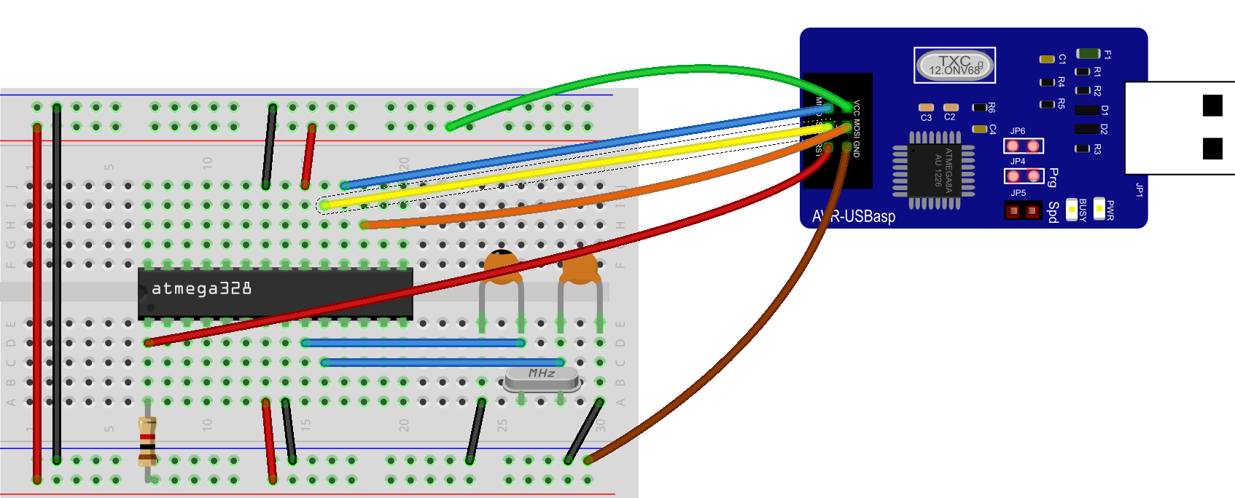
Why Development Board ?
Microcontroller or Microprocessor has multiple Pins but doesn’t have Port and other Peripheral devices.
To Interface we need to design electronics circuit.
Electronics Circuit design require specific skill set and knowledge.
Development board provides this all ready made.
Development board provides environment, where we can directly program controller or processor without worrying about circuit designing.

Slide 15
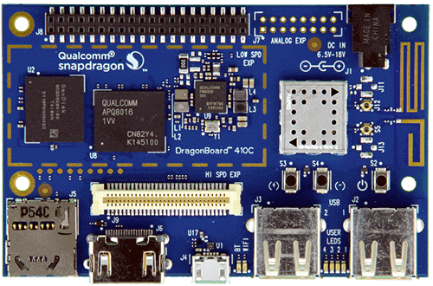
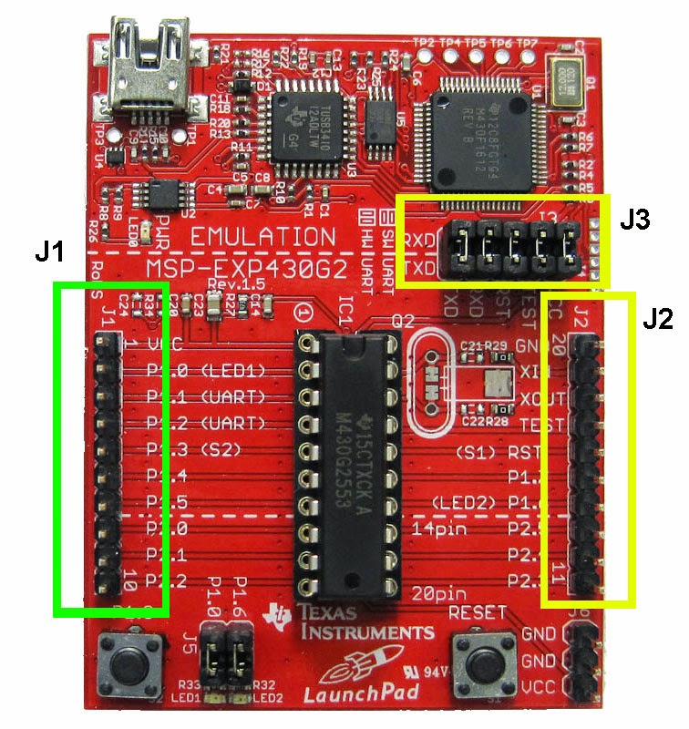
Development Board
We are not going to Design Development Board.
Various Development Board already available.

Slide 16

What is Arduino?
Arduino is an open-source electronics platform based on easy-to-use hardware and software.
Software : Arduino Software (IDE), based on Processing tool.
Arduino programming language (based on Wiring)
Hardware: Arduino Board can be instructed by sending a set of instructions to the microcontroller on the board.
Arduino boards are able to read inputs likes light on a sensor, a finger on a button, or a twitter message and turn it into an output likes activating a motor, turning on an LED, publishing something online.

Slide 17
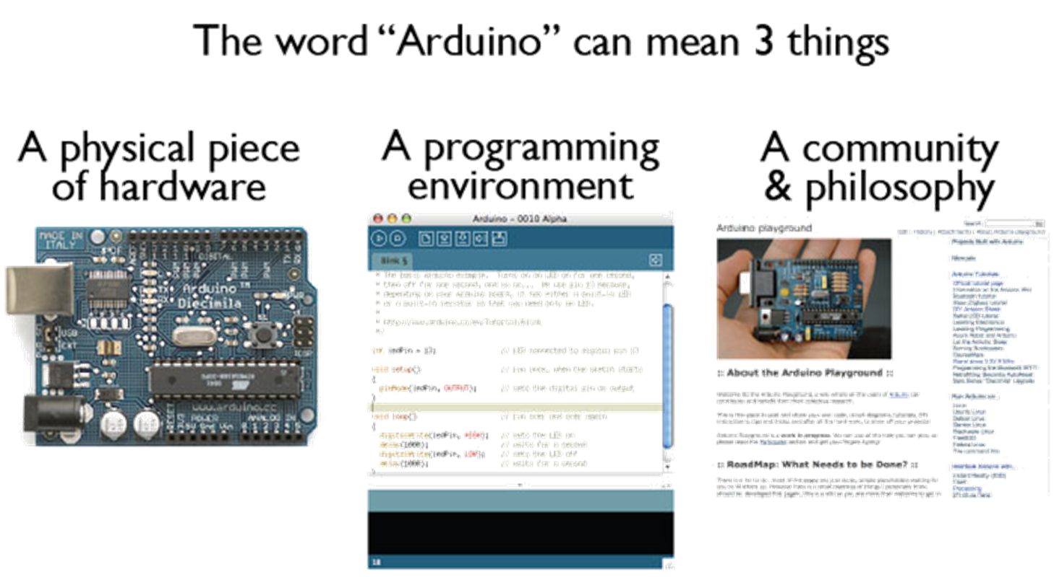
Arduino

Slide 18
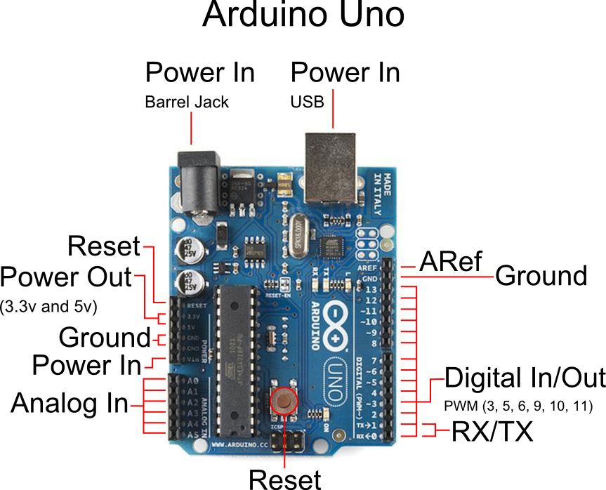
The Arduino Development Board - UNO

Slide 19
Arduino Shields
Arduino shields are the boards, which are plugged over the Arduino board to expand its functionalities.
Why do we need Shields?
It adds new functionalities to the Arduino projects.
The shields can be attached and detached easily from the Arduino board. It does not require any complex wiring.
It is easy to connect the shields by mounting them over the Arduino board.
The hardware components on the shields can be easily implemented.

Slide 20
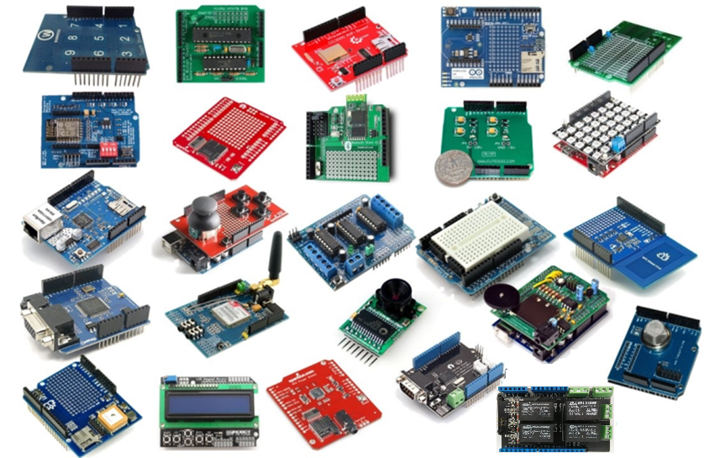
Arduino UNO Shield

Slide 21
AVR Boot-loader
Boot loader
A boot loader, also called a boot manager, is a small program that places the operating system (OS) of a computer into memory.
When a computer is powered-up or restarted, the basic input/output system (BIOS) performs some initial tests, and then transfers control to the Master Boot Record (MBR) where the boot loader resides
The AVR Boot-loader allows the programming or re-programming of the target AVR microcontroller using the PC serial port instead of a traditional programmer.
Once the AVR Boot-loader is programmed into the microcontroller, it remains until the chip is erased

Slide 22
Firmware
Firmware means the permanent software programmed into a read-only memory.
Firmware is like a software of a product.
So, Two categories of firmware are used in Arduino:
Boot-loader : (Default program for Chip startup)
USB-TTL
ATMEL Chip
The firmware:
(USB-TTL logic program) in the USB chip
Sketch in Arduino chip ( User Program i.e. LED Blink)
Just like we flash to install/update EEPROM firmware of a bios in the PC, we flash the Arduino boot-loader in a chip.

Slide 23
Arduino block diagram
Arduino UNO
13 12 ~11 ~10 ~9 8 7 6 ~5 ~4 ~3 2 1 0
Digital Input / Output Port
~PWM
Power Supply
USB Port
Serial Communication
USB-TTL
Micro- Controller
ATMega328P
ADC – 10 bit
Power Supply
DC In
Power Port
Analog Input
A0-A5
3.3v 5v Vin Aref GnD(Ground)

Slide 24
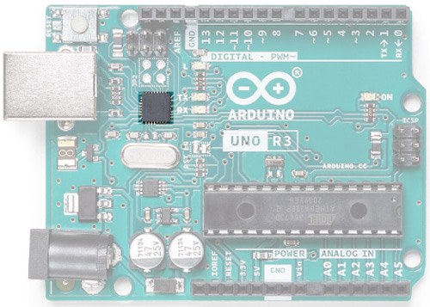
USB - B Socket USB-TTL Interface Chip
The USB socket on the UNO has two functions.
One is for communication.
Connect with the computer through a USB port.
To load the firmware into the Arduino with the help of the boot-loader.
Second is to power the Arduino.
The USB port can be use to power the Uno directly from any USB port.
To communicate with the computer, the Arduino relies on a USB-TTL interface.
In UNO, ATMega16U with custom firmware act as a USB–TTL interface chip.

Slide 25
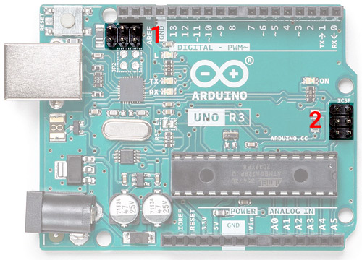
ICSP Pins- (In-circuit serial programming)
Two 6 pin connectors.
One is near the USB – TTL Chip
At the end of the board.
These pins are used to program those two microcontrollers.
The USB – TTL chip on this board is an ATMgega16U.
The connector marked as 1 is used to program the USB-TTL firmware into this chip.
The connector marked as 2 is used to burn the boot-loader into the ATMega328 microcontroller.

Slide 26
Four code on Arduino Board:
USB – TTL chip : ATMega16U2
Boot loader on the Atmega16U2 (USB to Serial) chip
Main code on the Atmega16U2
ATMega328 microcontroller
Boot loader on the Atmega328P (main) chip
Main code on the Atmega328P

Slide 27
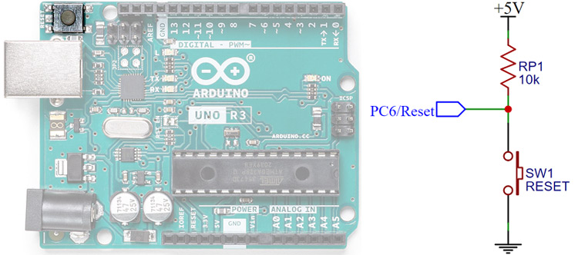
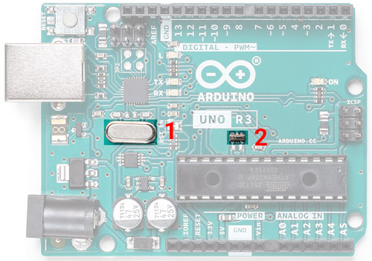
Reset Button Crystal Oscillator/ Ceramic resonator
To reset the ATMega328 microcontroller
It’s connected to the PC6/Reset pin, which is pulled up through a 10K.
When the switch is pressed the pin is pulled to the ground and the chip(ATMega328 microcontroller) will reset.
For a microcontroller to work it needs a clock source.
The clock circuit determines the speed with which the microcontroller operates.
How many instructions per second it will execute is dependent on the clock frequency.
The first one is a 16MHz crystal oscillator used for the ATMega16U2 chip
The second one is a 16MHz resonator used for the ATMega328P microcontroller.

Slide 28
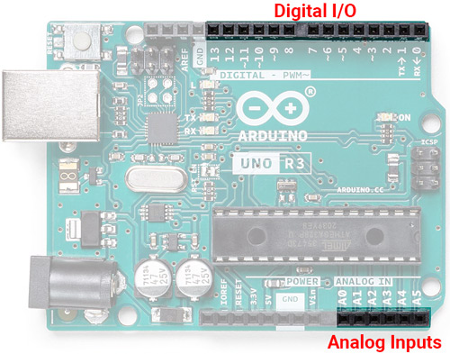
Digital and Analog I/O
The Arduino UNO has 14 digital I/O pins and 6 Analog inputs.
The digital I/O pins are 5V logic level and you can also use the Analog pins as digital I/O too.
Arduino UNO supports 10 bit ADC inputs through A0-A5, which can be sampled and analyzed using UNO.(ADC Analog to digital Converter)
Analog input Signal converted into Digital through ADC.

Slide 29
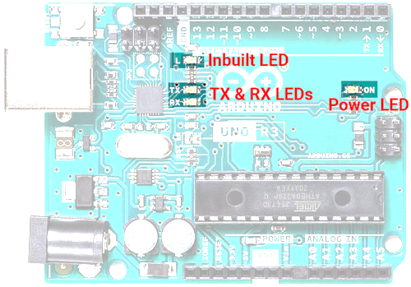
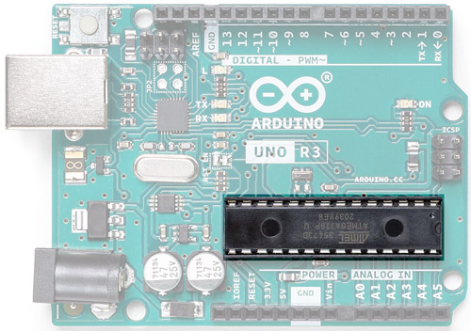
ATMega328P – The Brain On-Board LED
The main component on the Arduino board – the ATMega328P Microcontroller.
Atmega328P is pre-programmed with a boot-loader that allows you to directly upload the program to Arduino through USB without the need for an external programmer.
Uno has 4 LEDs onboard.
One is used as a power indicator.
Two LED are used to show the activity of the Rx and Tx pin.
Rx -Receiver , Tx-Transmission
Rx LED
Tx LED
The other one is tied to the Digital pin 13, which can be used to test the Arduino board or simply as an indicator.
LED - Inbuilt

Slide 30
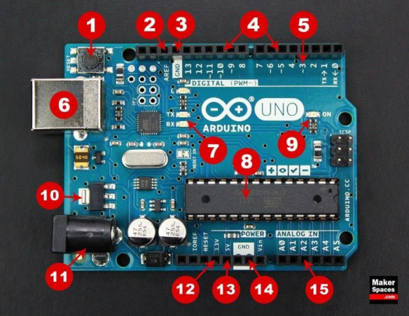
Arduino Uno - Components
1.Reset Button – This will restart any code that is loaded to the Arduino board
2.AREF–Stands for “Analog Reference” and is used to set an external reference voltage
3.Ground Pin – There are a few ground pins on the Arduino and they all work the same
4.Digital Input/Output – Pins 0-13 can be used for digital input or output.
5. PWM – The pins marked with the (~) symbol can simulate analog output

Slide 31
Arduino Uno - Components
6. USB Connection –Used for powering up your Arduino and uploading sketches
7. TX/RX – Transmit and receive data indication LEDs
8. ATmega Microcontroller – This is the brains and is where the programs are stored.
9.Power LED Indicator –This LED lights up anytime the board is plugged in a power source
10.Voltage Regulator – This controls the amount of voltage going into the Arduino board

Slide 32
Arduino Uno - Components
11.DC Power Barrel Jack – This is used for powering your Arduino with a power supply
12.3.3V Pin – This pin supplies 3.3 volts of power to your projects
13. 5V Pin – This pin supplies 5 volts of power to your projects
14. Ground Pins – There are a few ground pins on the Arduino and they all work the same
15. Analog Pins – These pins can read the signal from an analog sensor and convert it to digital

Slide 33

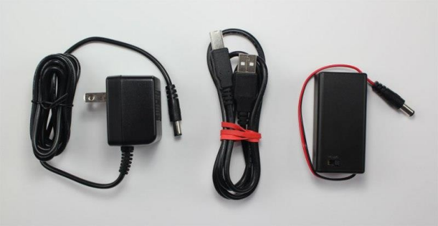
Arduino Power Supply
The Arduino Uno needs a power source in order for it to operate and can be powered in a variety of ways.
Connect the board directly to your computer via a USB cable.
If you want your project to be mobile/ remote, consider using a 9V battery pack.
The last method would be to use a 9V DC power supply.

Slide 34
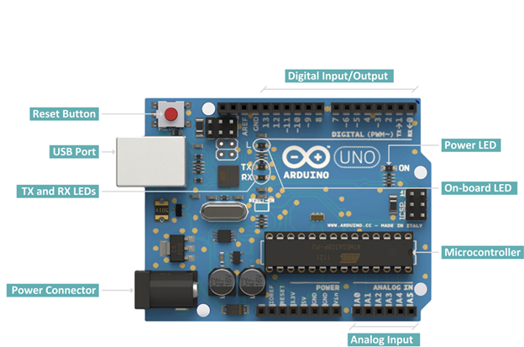
Arduino Uno – Digital And Analog Pins
Digital pins:
14 digital IO pins
6 are PWM pins (3, 5, 6, 9, 10, and 11).
Analog pins:
6 analog pins(A0, A1, A2, A3, A4, and A5)
Takes analog values as an input

Slide 35
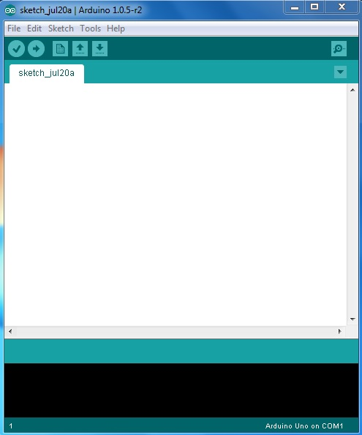
Arduino IDE
VERIFY
SERIAL MONITOR
UPLOAD
NEW TAB
OPEN
CODE GOES HERE
SAVE
BOARD & SERIAL PORT SELECTIONS

Slide 36
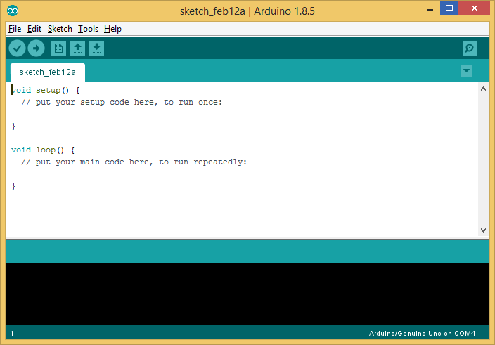
Arduino IDE
IDE : Integrated Development Environment.
1.) Code Editor
It is the space where we can write the code
2.) Text Console
For displaying the messages.
3.) Toolbar with buttons
For common functions to perform.
4.) Menu bar
A menu bar with series of menus.
4
3
1
2

Slide 37
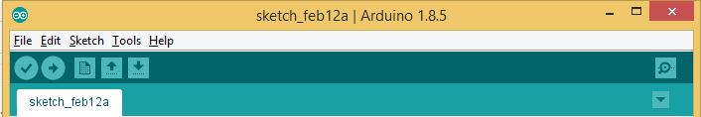
Arduino IDE - Toolbar
The functions of buttons in toolbar can be explained as following:
Verify
Checks your code for errors compiling it.
Open
Presents a menu of all the sketches in your sketchbook. Clicking one will open it within the current window overwriting its content.
Upload
Compiles your code and uploads it to the configured board.
Save
Saves your sketch.
New
Creates a new sketch.
Serial Monitor
Opens the serial monitor.

Slide 38
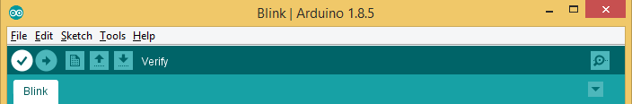
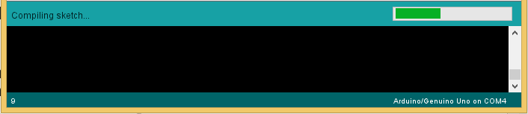
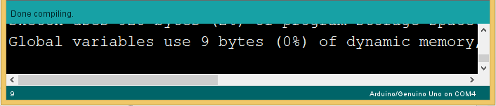
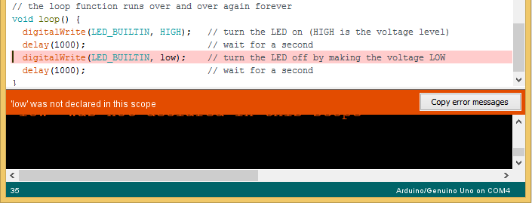
Compiling the Code
To compile a code in Arduino click on the “Verify” button in menu bar.
While compiling the code, a message “Compiling sketch” is shown with its progress in the status bar.
If there is no error in the code, the message “Done compiling” is displayed in the status bar.

Slide 39
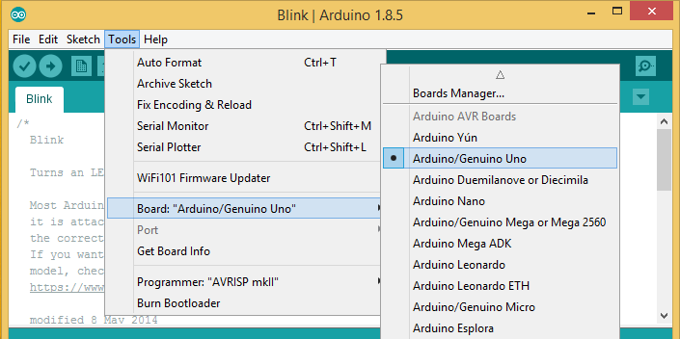
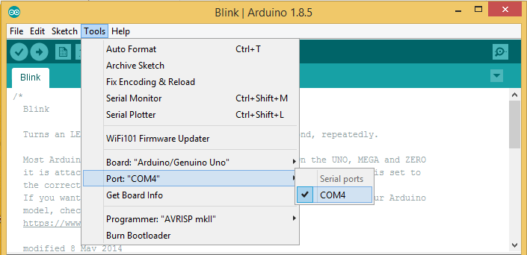
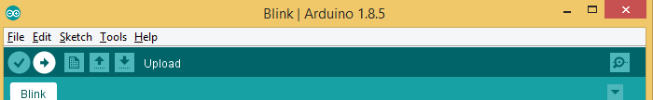
Upload the first code in Arduino Hardware
Select the proper board type:
First, we need to select the appropriate board type in which we need to upload the program.
Go to Tools > Board menu and select the board which is used as the hardware.
Select port: Select the serial device of the board from the Tools > Port menu.
This is likely to be COM3 or higher (COM1 and COM2 are usually reserved for hardware serial ports).

Slide 40
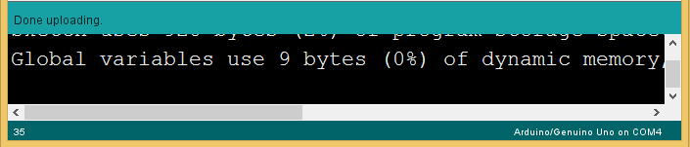
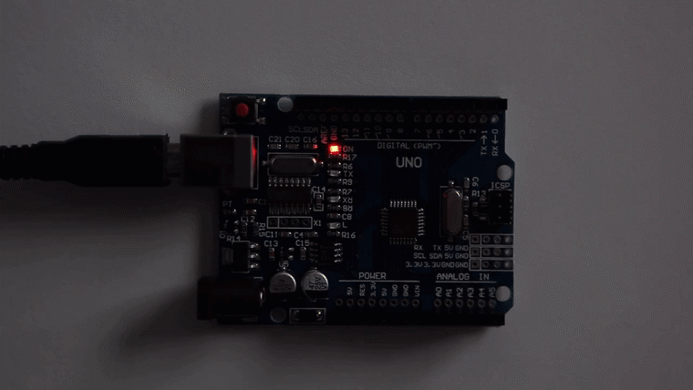
Upload the first code in Arduino Hardware
While uploading process, TX and RX LED will be flashing.
If uploading is done successfully, it will show a message “Done uploading” in the status bar.
Once the program is uploaded, the built-in LED of the Arduino board will flash with one second delay.

Slide 41
Basic Coding Structure
void setup() {
// put your setup code here, to run once:
}
void loop() {
// put your main code here, to run repeatedly:
}

Slide 42
Basic Coding Structure
setup() function
Called only once, when Board starts.
To initialize variables, pin modes, start using libraries, etc.
It is called only when the Arduino is powered on or reset.
loop() function
The loop functions runs continuously till the device is powered off.
The main logic of the code goes here.
Similar to while (1) for micro-controller programming.
Code in the loop() section of the sketch is used to actively control the Arduino board.
Commenting
Any line that starts with two slashes (//) will not be read by the compiler.

Slide 43
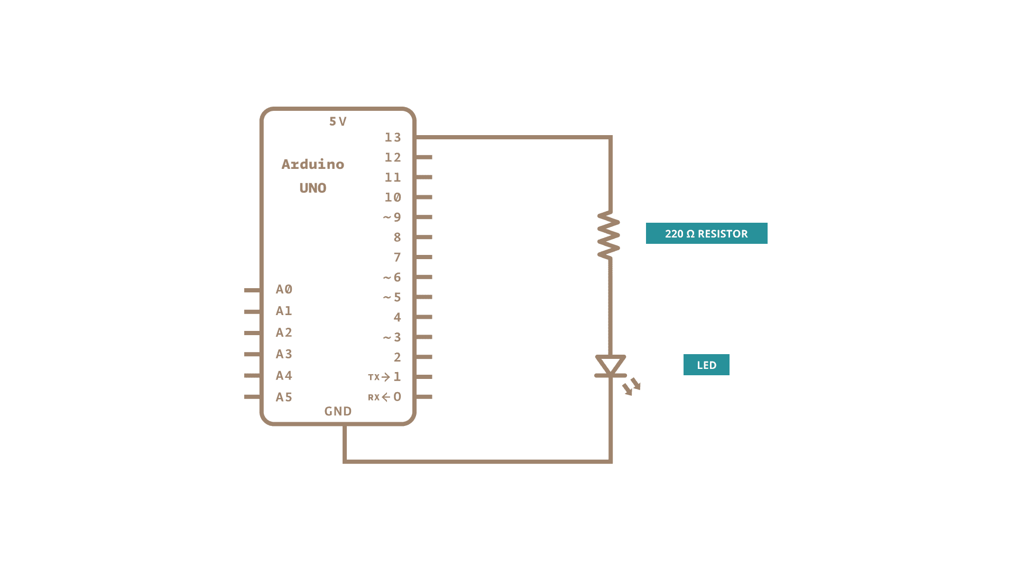


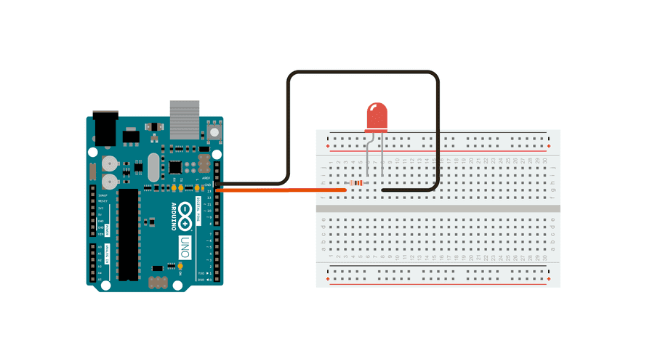
Program 1 : Blink LED : Schematic

Slide 44
Sketch
We should initialize the pin as input or output once only.
Therefore the syntax for defining the pin as output is written in void setup ( ) function.
The code inside the loop() function runs continuously. void loop() behaves as while(1).
Blink.ino
1
2
3
4
5
6
7
8
9
void setup() {
pinMode(LED_BUILTIN, OUTPUT);
}
void loop() {
digitalWrite(LED_BUILTIN, HIGH);
delay(1000);
digitalWrite(LED_BUILTIN, LOW);
delay(1000);
}
Initialize digital pin LED_BUILTIN which is at pin 13 as an output.
turn ON the LED by writing HIGH voltage level
A delay of 1000ms = 1 sec
turn OFF the LED by writing LOW voltage level
A delay of 1000ms = 1 sec

Slide 45
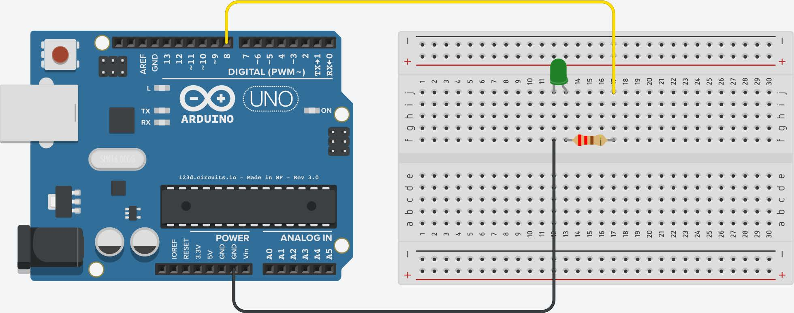
Program 2 : LED on/off

Slide 46
Sketch
sketch_01.ino
1
2
3
4
5
6
7
8
9
10
11
12
void setup() {
pinMode(8, OUTPUT);
}
void loop() {
digitalWrite(8, HIGH); // Turn on the LED
delay(1000); // Wait for one second
digitalWrite(8, LOW); // Turn off the LED
delay(1000); // Wait for one second
}

Slide 47
Data Types : void & Boolean
Void
The void keyword is used only in function declarations.
The function is expected to return no information.
Example : void loop ( )
{ // rest of the code }
Boolean
A Boolean holds one of two values, true or false.
Each Boolean variable occupies one byte of memory.
Example:
bool val = false ;
bool state = true ;

Slide 48
Data Types : byte and word
byte
A byte stores an 8-bit unsigned number (from 0 to 255)
Example: byte m = 25 ; //declaration of variable with type byte and initialize it with 25
word
On the Uno and other ATMEGA based boards, a word stores a 16-bit unsigned number.
Example: word w = 1000 ;
//declaration of variable with type word and initialize it with 1000

Slide 49
Data Types : int
Int
Integers are the primary data-type for number storage.
int stores a 16-bit (2-byte) value. (For UNO)
This yields a range of -32,768 to 32,767 (minimum value of -2^15 and a maximum value of (2^15) - 1)
The int size varies from board to board, On the Arduino Due, int stores a 32-bit (4-byte) value.
Example: int counter = 32 ; // declaration of variable with type int and initialize it with 32
unsigned int
Instead of storing negative numbers, however, they only store positive values, yielding a useful range of 0 to 65,535 (2^16) - 1).
Same as word data type.
Example : unsigned int counter = 60 ; // declaration of variable with

Slide 50
Data Types : Char
char
one byte of memory that stores a character value
Character literals are written in single quotes like this: 'A' and for multiple characters, strings use double quotes: "ABC".
However, characters are stored as numbers (ASCII value),This means that it is possible to do arithmetic operations on characters, in which the ASCII value of the character is used.
For example, 'A' + 1 has the value 66, since the ASCII value of the capital letter A is 65.
Example:
char cha = ‘a’;
char chc = 97 ;

Slide 51
Data types : long and unsigned long
long
Long variables are extended size variables for number storage, and store 32 bits (4 bytes).
From -2,147,483,648 to 2,147,483,647.
Example: long velocity = 102346 ;
unsigned long
unsigned long variables are extended size variables for number storage and store 32 bits (4 bytes).
Unlike standard long, unsigned longs will not store negative numbers, making their range from 0 to 4,294,967,295 (2^32 - 1).
Example : unsigned long velocity = 101006 ;

Slide 52
Data Types : Float and Double
float
Data type for floating-point number is a number that has a decimal point.
Floating-point numbers are often used to approximate the analog and continuous values because they have greater resolution than integers.
Floating-point numbers can be as large as 3.4028235E+38 and as low as -3.4028235E+38.
They are stored as 32 bits (4 bytes) of information.
Example : float num = 1.352;
double
On the Uno and other ATMEGA based boards, Double precision floating-point number occupies four bytes.
The double implementation is exactly the same as the float, with no gain in precision.
Example: double num = 45.352 ;

Slide 53
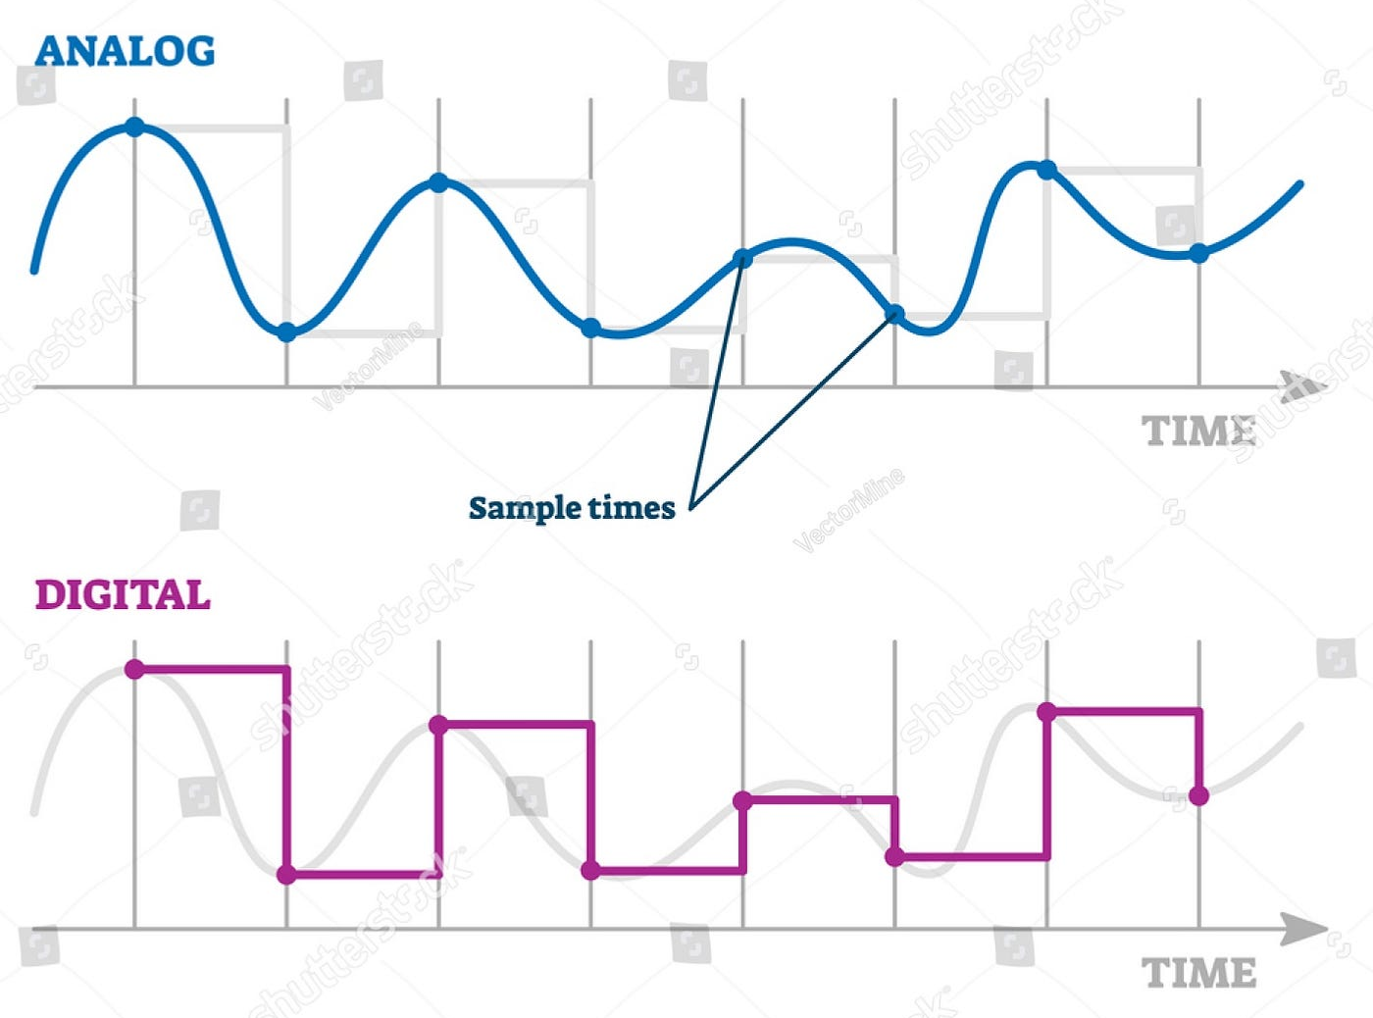
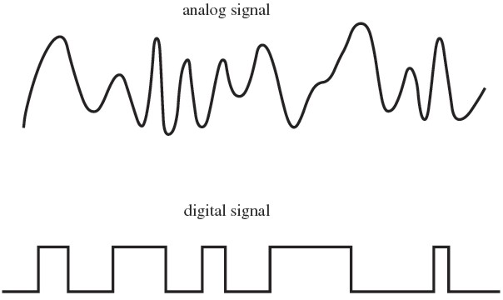
Digital And Analog

Slide 54
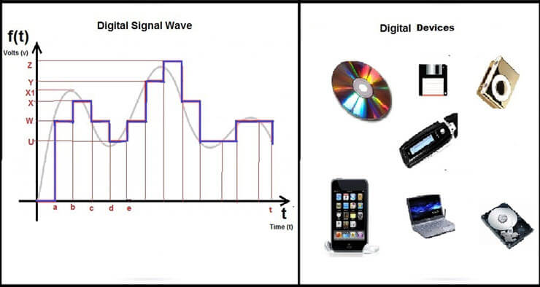
Analog to Digital

Slide 55
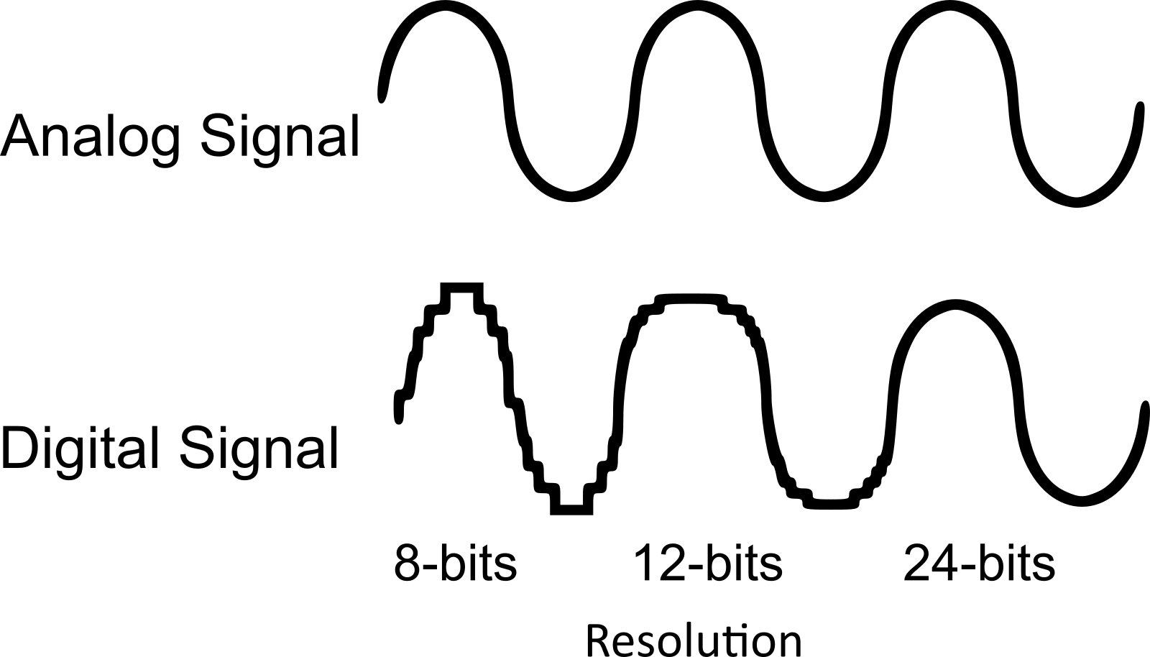
ADC Resolution

Slide 56
Functions in Arduino IDE-Digital Functions
Digital Input - Output
digitalRead()
digitalWrite()
pinMode()

Slide 57
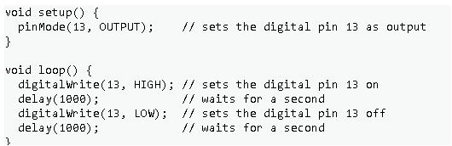
Pin - Mode
pinMode():
Used in void setup() to configure a specified pin to behave either as an INPUT or an OUTPUT.
Syntax
pinMode(pin, mode)
pin: Arduino pin number to set the mode of.
mode: INPUT, OUTPUT, or INPUT_PULLUP.
Example:

Slide 58
Digital Output
digitalWrite():
Write a HIGH or a LOW value to a digital pin. HIGH means Logic 1. It will set 5V on the configured pin of Arduino
Syntax
digitalWrite(pin, value)
pin: Arduino pin number.
value: HIGH or LOW.
Example:

Slide 59
Digital Input
digitalRead():
Reads the value from a specified digital pin, either HIGH or LOW.
Syntax
digitalRead(pin)
pin: the Arduino pin number you want to read
Example:
DigitalRead.ino
1
2
3
4
5
6
7
8
void setup() {
pinMode(10,INPUT); //Pin 10 as Input pin
}
void loop() {
int data = digitalRead(10); //read the data on Pin 10
}

Slide 60
Program : Write code to read data from obstacle sensor
obstacle.ino
1
2
3
4
5
6
7
8
9
10
11
12
13
14
15
16
int obstacle = 0;
void setup() {
pinMode(2, INPUT); //pin 2 as Input pin
pinMode(13, OUTPUT); //In Built LED as Output
Serial.begin(9600); } //Start Serial Communication
void loop() {
obstacle = digitalRead(2); // Read from Pin:2
if (obstacle == LOW) {
Serial.print("Obstacle is present");
digitalWrite(13, HIGH);
}
else {
digitalWrite(13, LOW);
}
delay(1000);
}

Slide 61
1 bit ADC [For Digital Input] (Analog To Digital)
1.5
ADC
4
3
3.5
1
2.5
4.2
5
6
4.8
1.2
2
0
3.8
1.1
0.5

Slide 62
1 bit DAC [For Digital Output] (Digital To Analog)
DAC
1
0 volt
5 volt
0

Slide 63
Functions in Arduino IDE-Analog Functions
Analog Input - Output
analogRead()
analogWrite()
analogReference()

Slide 64
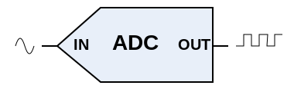
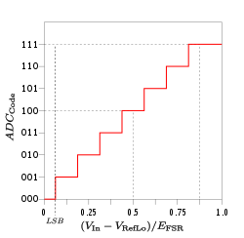
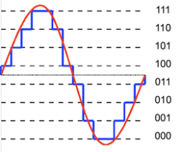
Analog Input with ADC : Analog to Digital
0
10
100
0volt
To 5volt
200
500
800
1000
2¹⁰ =1024
1023

Slide 65
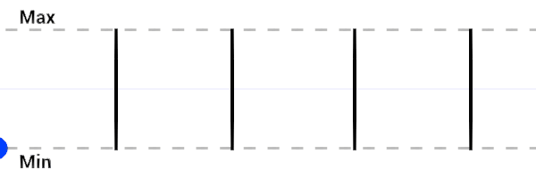
Digital Pin Output

Slide 66
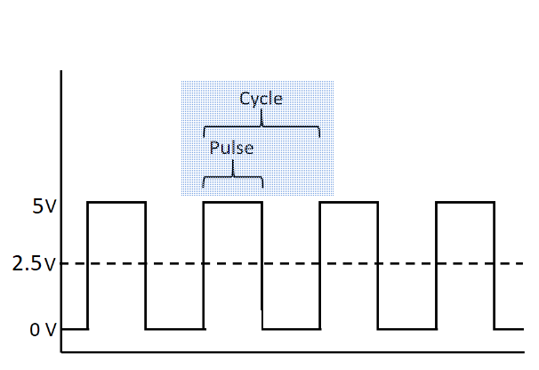
Digital Signal : Square wave

Slide 67
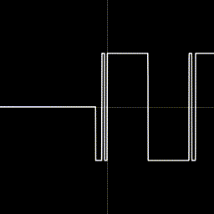
PWM : Pulse Width Modulation
Pulse-width modulation (PWM), also known as pulse-duration modulation (PDM) or pulse-length modulation (PLM).
It is a method of controlling the average power or amplitude delivered by an electrical signal.
The average value of voltage (and current) fed to the load is controlled by switching the supply between 0 and 100%.

Slide 68
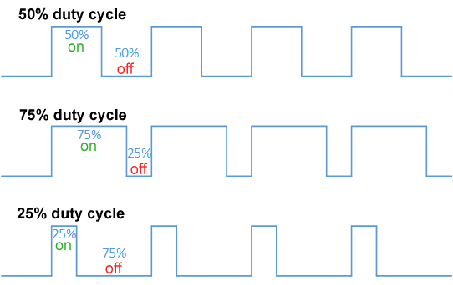
PWM : Pulse Width Modulation Duty Cycle variation

Slide 69
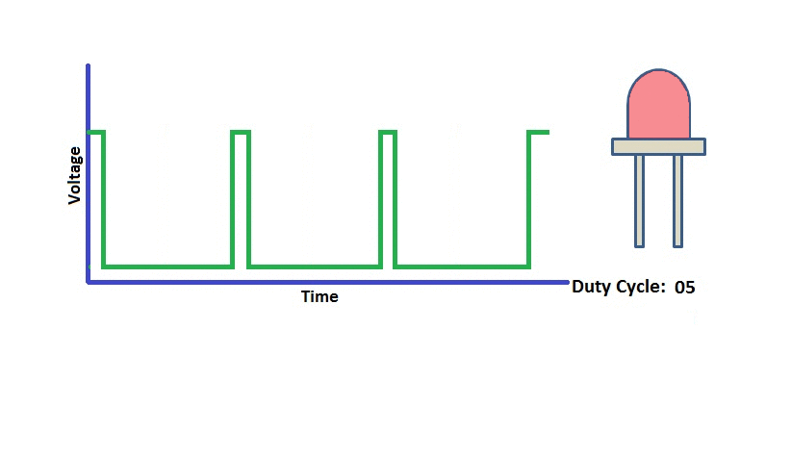
LED Fading with PWM

Slide 70
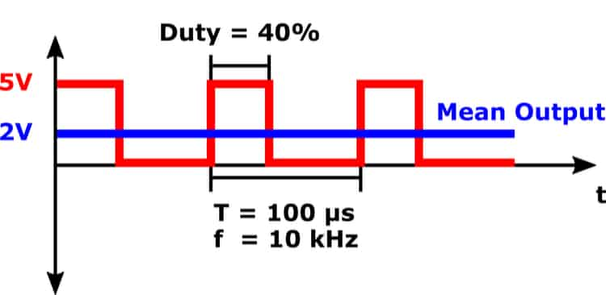
PWM Signal

Slide 71


Arduino UNO : Analog OUT
2⁸ =256

Slide 72

Arduino UNO :PWM

Slide 73
Analog Input
analogRead():
Reads the value from the specified analog pin.
Arduino boards contain a multichannel, 10-bit analog to digital converter.
This means that it will map input voltages between 0 and the operating voltage(5V or 3.3V) into integer values between 0 and 1023.
Syntax
analogRead(pin)
pin: the name of the analog input pin to read from (A0 to A5) (for Arduino UNO only)

Slide 74
Program : Write a code to read data from gas sensor
gasSensor.ino
1
2
3
4
5
6
7
8
9
10
11
12
13
14
15
16
int gas_level;
void setup() {
pinMode(A0, INPUT);
Serial.begin(9600);
} void loop() {
gas_level = analogRead(A0);
Serial.print("Gas Level : ");
Serial.println(gas_level);
delay(500);
}

Slide 75
Analog Output
analogWrite():
Writes an analog value (PWM wave) to a pin.
Can be used to light a LED at varying brightness or drive a motor at various speeds.
After a call to analogWrite(), the pin will generate a steady rectangular wave of the specified duty cycle until the next call to analogWrite() on the same pin.
Syntax
analogWrite(pin, value)
pin: Arduino pin to write (Arduino UNO ~PWM : 3,5,6,9,10,11)
value: 0-255
The duty cycle: between 0 (always off) and 255 (always on).
Allowed data types: int.

Slide 76
Program: Read from the potentiometer and set LED brightness accordingly.
potentioMeter.ino
1
2
3
4
5
6
7
8
9
10
11
12
13
14
15
16
ledPin = 9; // LED connected to digital pin 9
int analogPin = 3; // potentiometer connected to analog pin 3
int val = 0; // variable to store the read value
void setup() {
pinMode(ledPin, OUTPUT); // sets the pin as output
}
void loop() {
val = analogRead(analogPin); // read the input pin
analogWrite(ledPin, val / 4);
// analogRead values go from 0 to 1023
//analogWrite values from 0 to 255
}

Slide 77
Serial Communication Functions
Serial:
Used for communication between the Arduino board and a computer or other devices.
begin()
println()
print()

Slide 78
To start Serial communication
Serial.begin()
It is used to start serial communication between Arduino board and other device.
Normally, it is connected with computer for monitoring the data.
Serial communication uses pin 0 and 1 also working as Rx and Tx respectively.
Syntax:
Serial.begin(baud_rate)
Serial.begin(speed, config)
speed: in bits per second (baud). Allowed data types: long.
config: sets data, parity, and stop bits.

Slide 79

Functions in Arduino Communication Functions
Example: LDR(Light Dependent Resistor) Sensor Interfacing with Arduino
LDR.ino
1
2
3
4
5
6
7
8
9
10
11
12
13
void setup(){
pinMode(A0, INPUT);
Serial.begin(9600); }
void loop(){
int light_intensity = analogRead(A0);
if (light_intensity > 800){
Serial.println(“Darker");
}
else if (light_intensity < 500){
Serial.println(“Too Bright");
}
delay(1000);
}

Slide 80
To print value on serial monitor.
Serial.println()
Print the data with newline from Arduino to other device.
Prints data to the serial port as human-readable ASCII text followed by a carriage return character (ASCII 13, or ‘\r') and a newline character (ASCII 10, or ‘\n').
Syntax:
Serial.println(val)
Serial.println(val, format)
val: the value to print. Allowed data types: any data type.
format: specifies the number base (for integral data types) or number of decimal places (for floating point types).

Slide 81
To print value on serial monitor.
serialPrint.ino
1
2
3
4
5
6
7
8
9
10
11
12
13
14
int analogValue = 0; // variable to hold the analog value
void setup() {
Serial.begin(9600); // open the serial port at 9600 bps: }
void loop() {
analogValue = analogRead(A0);
// read the analog input on pin A0
// print it out in many formats:
Serial.println(analogValue); // print as an ASCII-encoded decimal Serial.println(analogValue, DEC); // print as an ASCII-encoded decimal Serial.println(analogValue, HEX); // print as an ASCII-encoded hexadecimal Serial.println(analogValue, OCT); // print as an ASCII-encoded octal Serial.println(analogValue, BIN); // print as an ASCII-encoded binary
// delay 10 milliseconds before the next reading:
delay(10); }

Slide 82
To print value on serial monitor
Serial.print()
Print the data from Arduino to other device.
Syntax
Serial.print(val)
Serial.print(val, format)
val: the value to print.
Allowed data types: any data type.
helloWorld.ino
1
2
3
4
5
6
7
void setup(){
Serial.begin(9600); }
void loop(){
Serial.print(“Hello");
Serial.println(“ Arduino");
}

Slide 83
Functions in Arduino IDE-Time Functions
Time Functions:
delay()
delayMicroseconds()
millis()
micros()

Slide 84
Delay in milliseconds
delay()
Pauses the program for the amount of time (in milliseconds) specified as parameter.
Syntax
delay(ms)
ms: the number of milliseconds to pause.
Allowed data types: unsigned long.
Example:

Slide 85

Delay in Microseconds
delayMicroseconds()
It pauses the program for amount of time in microseconds specified as the parameter.
Syntax
delayMicroseconds(µs)
µs: the number of microseconds to pause. Allowed data types: unsigned int.
Example:

Slide 86
To keep the time since the Arduino program started.
millis()
Returns the number of milliseconds passed since the Arduino board has began running the current program.
This number will overflow (go back to zero), after approximately 50 days.
Syntax
Int time = millis()
micros()
Returns the number of microseconds since the Arduino board began running the current program.
This number will overflow (go back to zero), after approximately 70 minutes.
Syntax :
int time = micros()

Slide 87
Functions in Arduino IDE-Time Functions
Time.ino
1
2
3
4
5
6
7
8
9
10
11
12
13
14
15
16
unsigned long time1;
unsigned long time2;
void setup() {
Serial.begin(9600);
}
void loop() {
Serial.print("Time: ");
time1 = millis();
time2 = micros();
Serial.println(time1);
//prints time since program started in milliseconds
Serial.println(time2);
//prints time since program started in microseconds.
delay(1000);
//wait for 1 second so as not to send massive amounts of data
}

Slide 88
Functions in Arduino Math Functions
map()
max()
min()
pow()
sq()
sqrt()

Slide 89
Mapping
map():
Re-maps a number from one range to another.
A value of from_Low would get mapped to to_Low, a value of from_High to to_High, values in-between to values in-between, etc.
Syntax
map(value, from_Low , from_High , to_Low, to_High)
value: the number to map.
from_Low: the lower bound of the value’s current range.
from_High: the upper bound of the value’s current range.
to_Low: the lower bound of the value’s target range.
to_High: the upper bound of the value’s target range.

Slide 90

Mapping
/* Map an analog value to 8 bits (0 to 255) */
void setup() {
pinMode(A0,INPUT);
}
void loop() {
int val = analogRead(A0);
val = map(val, 0, 1023, 0, 255);
analogWrite(9, val);
}

Slide 91
Maximum
max():
Calculates the maximum of two numbers
Syntax : max(x, y)
x: the first number. Allowed data types: any data type.
y: the second number. Allowed data types: any data type.
It returns the larger of the two parameter values.
Example:
sensVal = max(sensVal, 20); // assigns sensVal to the larger of sensVal or 20

Slide 92
Minimum
min():
Calculates the minimum of two numbers.
Syntax : min(x, y)
x: the first number. Allowed data types: any data type.
y: the second number. Allowed data types: any data type.
It returns the smaller of the two parameter values.
Example: sensVal = min(sensVal, 100); // assigns sensVal to the smaller of sensVal or 100

Slide 93
Power of Number
pow():
Calculates the value of a number raised to a power. pow() can be used to raise a number to a fractional power.
Syntax : pow(base, exponent)
base: the number. Allowed data types: float.
exponent: the power to which the base is raised. Allowed data types: float.
The result of the exponentiation.
Example: float z = pow(x, y);

Slide 94
Square of the Number
sq():
Calculates the square of a number.
Syntax : sq(x)
x: the number. Allowed data types: any data type.
The square of the number.
Example:
square.ino
1
2
3
4
5
6
7
8
9
void setup() {
Serial.begin(9600);
int x = 4;
double y = sq(x);
Serial.print("The square of ");
Serial.print(x);
Serial.print(" is ");
Serial.println(y);
}

Slide 95
Square root of the Number
sqrt():
Calculates the square root of a number.
Syntax : sqrt(x)
x: the number. Allowed data types: any data type.
The square root of the number.
Example:
sqrt.ino
1
2
3
4
5
6
7
8
9
void setup() {
Serial.begin(9600);
int x = 4;
double y = sqrt(x);
Serial.print("The square root of ");
Serial.print(x);
Serial.print(" is "); Serial.println(y);
}

Slide 96
Advanced Input Output Functions
pulseIn()
random()
randomSeed()

Slide 97
Measure duration of HIGH or LOW pulse
pulseIn()
Reads a pulse HIGH or LOW from specified pin and wait for the time to go the pulse from HIGH to LOW or LOW to HIGH.
Returns the length of the pulse in microseconds or gives up and returns 0 if no complete pulse was received within the timeout.
Works on pulses from 10 microseconds to 3 minutes in length.
Syntax
pulseIn(pin, value)
pulseIn(pin, value, timeout)
pin: the number of the Arduino pin on which you want to read the pulse.
value: type of pulse to read: either HIGH or LOW.
timeout (optional): the number of microseconds to wait for the pulse to start; default is one second.

Slide 98
Example : pulseIn()
pulseIn.ino
1
2
3
4
5
6
7
8
9
10
int pin = 7;
unsigned long duration;
void setup() {
Serial.begin(9600);
pinMode(pin, INPUT);
}
void loop() {
duration = pulseIn(pin, HIGH);
Serial.println(duration);
}

Slide 99
Random number generation
random()
The random function generates pseudo-random numbers.
Syntax
random(max)
random(min, max)
min: lower bound of the random value, inclusive (optional).
max: upper bound of the random value, exclusive.
randomSeed()
it initializes the pseudo-random number generator.

Slide 100
Example: random number generation
RandomNumber.ino
1
2
3
4
5
6
7
8
9
10
11
12
13
14
15
16
long ranNumber;
void setup() {
Serial.begin(9600); randomSeed(analogRead(A0));
}
void loop() {
ranNumber = random(300);
// generate a random number from 0 to 299
Serial.println(ranNumber);
ranNumber = random(10, 20);
// print a random number from 10 to 19
Serial.println(ranNumber);
delay(50);
}

Slide 101
Unit 2-C: Raspberry Pi
Introduction to Raspberry Pi
General Architecture od Raspberry Pi
Installing OS in Raspberry Pi
Introduction to Python
Programming Raspberry Pi

Slide 102

Raspberry Pi
Raspberry Pi is a single-board computers, developed by Raspberry Pi Foundation in association with Broadcom and perhaps the most inspiring computer available today.
Because of its low cost and open design, the model became far more popular than anticipated.
It is widely used to make gaming devices, fitness gadgets, weather stations, and much more.
In 2012, the company launched the Raspberry Pi and the current generations of regular Raspberry Pi boards are Zero, 1, 2, 3, and 4.
Notes:
102

Slide 103

Architecture, Layout and Interface of Raspberry Pi
Processor
HDMI Port
USB Port
Ethernet Port
SD Card Slot
Camera Connector
Composite Video Output
Audio Output
Micro USB Power
GPIO Pins
Status LEDs
Notes:
103

Slide 104
Operating System for Raspberry Pi
Raspberry Pi needs an operating system to work.
Raspberry Pi OS (previously called Raspbian) is an official supported operating system.
Raspberry Pi Imager is the quick and easy way to install Raspberry Pi OS and other operating systems to a microSD card, ready to use with your Raspberry Pi.
Download and install Raspberry Pi Imager to a computer with an SD card reader.
Put the SD card into card reader and Run Raspberry Pi Imager.
Notes:
104

Slide 105

NOOBS
NOOBS (New Out Of the Box Software) is an exclusive install manager for OS installation process in the SD card of Raspberry Pi.
NOOBS is extremely useful for beginners as it helps in easy OS installation without configuration process.
Different Operating system that could be installed using NOOBs are:
Raspbian Raspberry Pi OS
OpenELEC
Pidora
RaspBMC
RISC OS
Arch Linux ARM
Notes:
105

Slide 106

GPIO and the 40-pin Header
A powerful feature of the Raspberry Pi is the row of GPIO (general-purpose input/output) pins along the top edge of the board.
A 40-pin GPIO header is found on all current Raspberry Pi boards (unpopulated on Raspberry Pi Zero, Raspberry Pi Zero W and Raspberry Pi Zero 2 W).
Prior to the Raspberry Pi 1 Model B+ (2014), boards comprised a shorter 26-pin header.
One of the things that makes the Raspberry Pi better for learning electronics than most other computers is its ability to control the voltage on several of its easily accessible pins.
GIOP header contains outputs for 3.3V, 5V, Ground, and lots of General Purpose Input/Output (GPIO) pins!
Notes:
106

Slide 107
Programming
Python is a powerful programming language that’s easy to use easy to read and write and, with Raspberry Pi.
Python syntax is clean, with an emphasis on readability, and uses standard English keywords. To control hardware connected to the Raspberry Pi we will use Python.
One should be familiar with some of the basics of Python, including literals, variables, operators, control flow, scope, and data structures.
We'll use the RPi.GPIO module to control all the GPIO of Raspberry Pi
Pin Out in detail : https://pinout.xyz/
What do these numbers mean?
GPIO - General Purpose Input/Output, aka "BCM" or "Broadcom". These are the big numbers, e.g. "GPIO 22".
You'll use these with RPi.GPIO and GPIO Zero.
Physical - or "Board" correspond to the pin's physical location on the header.
These are the small numbers next to the header, e.g. "Physical Pin 15".
WiringPi - for Gordon Henderson's Wiring Pi library. (Like Arduino lang.)
Rev 1 Pi - alternate GPIO/BCM numbers for the original, 26-pin model "A" and "B" Pi.

Slide 108

40 Pin (Raspberry Pi 4)

Slide 109
40 Pin (Raspberry Pi 4)

Slide 110
Python Programming for GPIO
Import the Rpi.GPIO module
import RPi.GPIO as GPIO
Pin Numbering Declaration
After you've included the RPi.GPIO module, the next step is to determine which of the two pin-numbering schemes you want to use:
GPIO.BOARD -- Board numbering scheme. (Physical)
The pin numbers follow the pin numbers on header P1.
GPIO.BCM -- Broadcom chip-specific pin numbers. (Broadcom)
These pin numbers follow the lower-level numbering system defined by the Raspberry Pi's Broadcom-chip brain.
To specify in your code which number-system is being used, use the GPIO.setmode() function.
GPIO.setmode(GPIO.BCM)
Both the import and setmode lines of code are required, if you want to use Python.

Slide 111
Python Programming for GPIO
Setting a Pin Mode
Similar to declare a "pin mode" in Arduino before you can use it as either an input or output.
To set a pin mode, use the setup([pin], [GPIO.IN, GPIO.OUT] function.
So, if you want to set pin 18 as an output,
GPIO.setup(18, GPIO.OUT)
Digital Outputs
To write a pin high or low, use the GPIO.output([pin], [GPIO.LOW, GPIO.HIGH]) function.
For example, if you want to set pin 18 high, write:
GPIO.output(18, GPIO.HIGH)
Writing a pin to GPIO.HIGH will drive it to 3.3V, and GPIO.LOW will set it to 0V.
Alternative to GPIO.HIGH and GPIO.LOW, you can use either 1, True, 0 or False to set a pin value

Slide 112
Python Programming for GPIO
Analog Outputs
PWM ("Analog") Output
PWM on the Raspberry Pi is about as limited as can be -- one, single pin is capable of it: 18 (i.e. board pin 12).
To initialize PWM, use GPIO.PWM([pin], [frequency]) function.
To make the rest of your script-writing easier you can assign that instance to a variable.
Then use pwm.start([duty cycle]) function to set an initial value.
For example...
pwm = GPIO.PWM(18, 1000)
pwm.start(50)

Slide 113
Python Programming for GPIO
Inputs
If a pin is configured as an input, you can use the GPIO.input([pin]) function to read its value.
The input() function will return either a True or False indicating whether the pin is HIGH or LOW.
You can use an if statement to test this, will read pin 17 and print whether it's being read as HIGH or LOW
if GPIO.input(17):
print("Pin 11 is HIGH")
else:
print("Pin 11 is LOW”)

Slide 114
Python Code for Blinking LED
Blink.py
1
2
3
4
5
6
7
8
9
10
11
12
import time
import RPi.GPIO as GPIO
led_pin = 12 # Pin definitions
GPIO.setmode(GPIO.BCM) # Use "GPIO" pin numbering
GPIO.setup(led_pin, GPIO.OUT) # Set LED pin as output
while True: # Blink forever
GPIO.output(led_pin, GPIO.HIGH) # Turn LED on
time.sleep(1) # Delay for 1 second
GPIO.output(led_pin, GPIO.LOW) # Turn LED off
time.sleep(1) # Delay for 1 second

Slide 115
Python Code for Blinking LED
Blink.py
1
2
3
4
5
6
7
8
9
10
11
12
13
14
15
#import the GPIO and time package
import RPi.GPIO as GPIO
import time
GPIO.setmode(GPIO.BOARD)
GPIO.setup(7, GPIO.OUT)
# loop through 50 times, on/off for 1 second
for i in range(50):
GPIO.output(7,True)
time.sleep(1)
GPIO.output(7,False)
time.sleep(1)
GPIO.cleanup() # Delay for 1 second

Slide 116
Internet of Things (IoT)
DU #2101CS631
DU #2301OE003
Prof. Bhushan D. joshi
Computer Engineering Department
bhushan.joshi@darshan.ac.in
+91 8485979997

